Slide 1
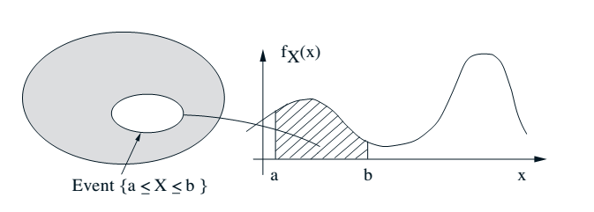
Continuous RVs
The RV can take on a continuum of values
Its probability distribution is captured by a probability density function
PDF

Slide 2
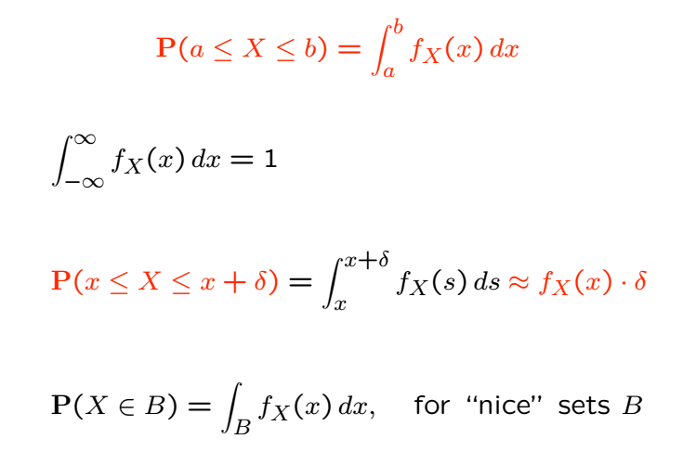
PDFs
Probability density function
Nonnegative function and integrates to unity
Integrate over a set to find probability of set
If continuous, probability that the RV is any fixed value is zero

Slide 3


Strangeness of PDFs
PDF evaluated at a value x is not a probability! E.g., is possible
Also,
Actually, for continuous RVs, RHS is zero.
Need to integrate to find probability (“density function”).

Slide 4
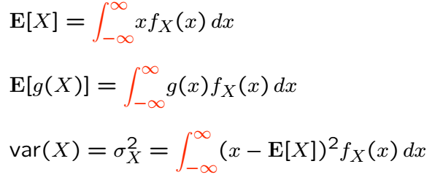
Means and Variances
Similar to discrete RVs
Replace PMFs with PDFs, and sums with integrals:

Slide 5
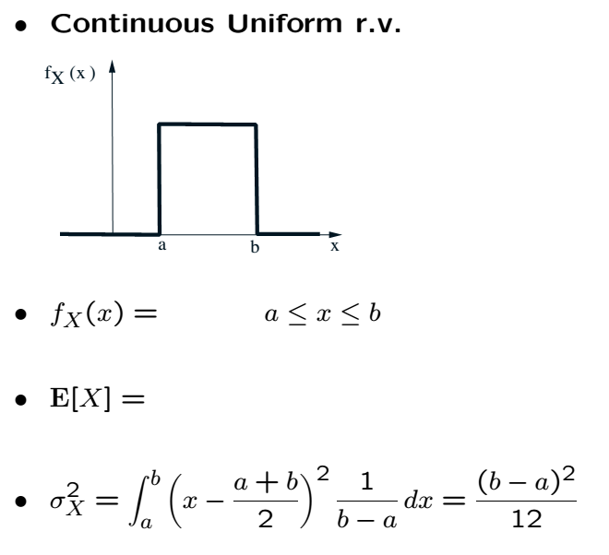
Example

Slide 6
Acknowledgements and Citations
Parts of these slides are adapted from the following resources:
Power Point Lecture Slides for the Textbook http://bcs.wiley.com/hebcs/Books?action=index&bcsId=8676&itemId=1118324560
John Tsitsiklis. 6.041 Probabilistic Systems Analysis and Applied Probability, Fall 2010. (Massachusetts Institute of Technology: MIT OpenCourseWare),http://ocw.mit.edu (Accessed 13 Apr, 2015). License: Creative Commons BY-NC-SA

